Slide 1
Biological Motion From Second-Order and Motion-Energy Cues across Eccentricity
Azim Chyngozhoev 20212003

Slide 2
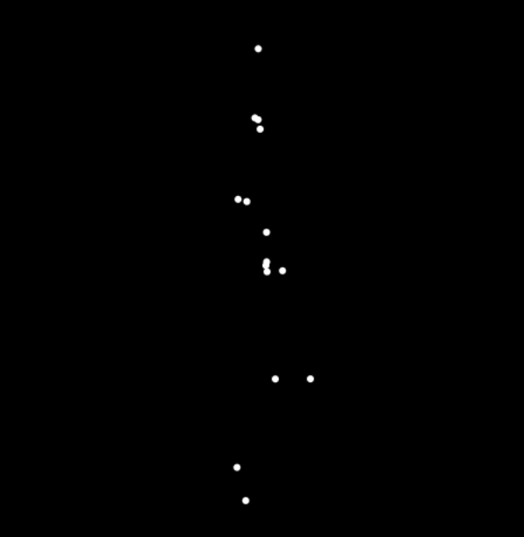
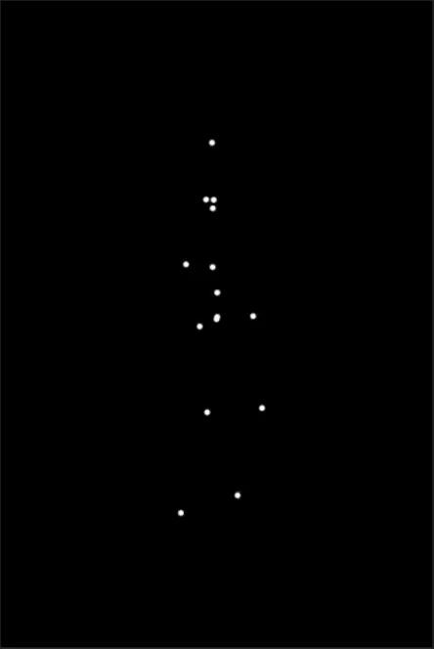
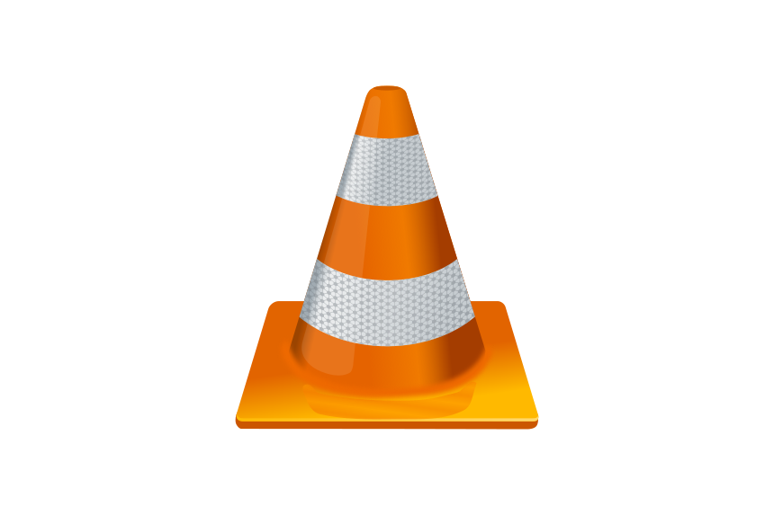
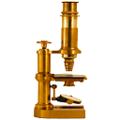

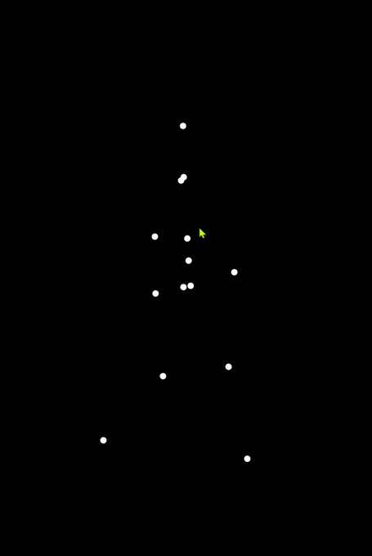
Experiment Design
60 frames
Biomotionlab.ca
10 frames
Dot Coordinates
y
x
VLC player
ImageJ
Python

Slide 3
Experiment Design
Reference PLW Dots:
Head
R Shoulder
L Shoulder
Chest
R Elbow
L Elbow
R Wrist
L Wrist
Stomach
R Hip
L Hip
R Knee
L Knee
R Ankle
L Ankle
PLW Dots Used:
Head
R Shoulder
L Shoulder
Chest
R Elbow
L Elbow
R Wrist
L Wrist
Stomach
R Hip
L Hip
R Knee
L Knee
R Ankle
L Ankle
Biomotionlab.ca
MATLAB
*Illustrated images do not correspond to experiment image (30fps GIF)

Slide 4
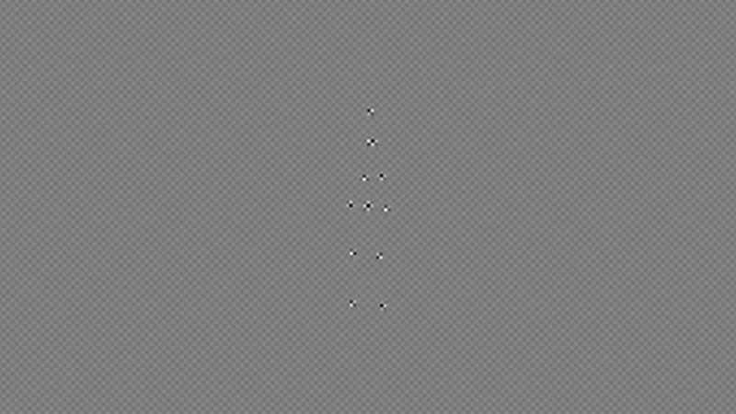
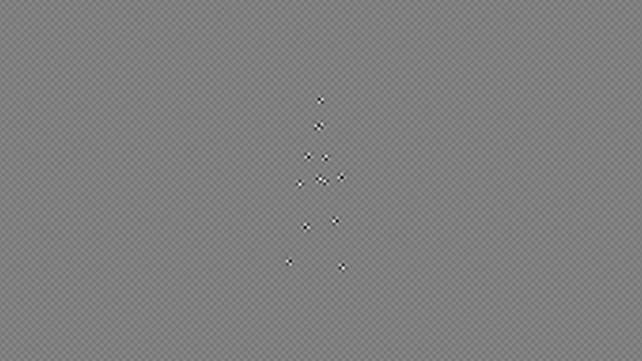
Motion types
Second order Motion Energy

Slide 5
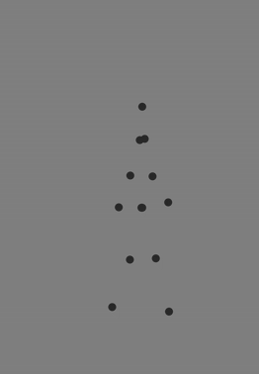
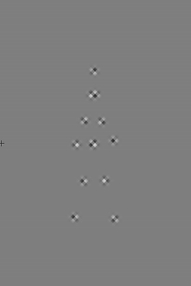
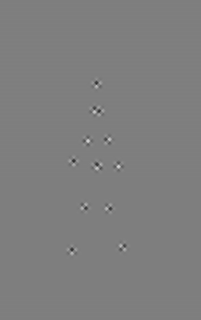
Experiment Design
Random starting frame
First Order (FO)
Second Order (SO)
Motion Energy (ME)
*Illustrated images do not correspond to experiment image (30fps GIF)

Slide 6
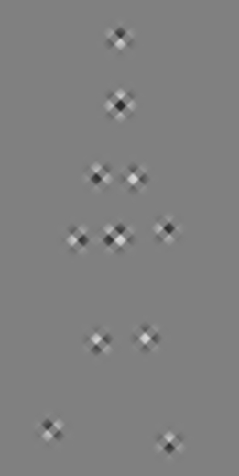
Ambiguity Calibration
Horizontal Squish
x' = cₓ + (x - cₓ) · sₓ
x = original X-coordinate of a point
cₓ ​ = horizontal center of the hips (reference)
sₓ ​∈ (0.1,1.0] = horizontal squish factor
Vertical Squish
yₘᵢ_{d} = (y_{A} + y_{B}) / 2
y' = yₘᵢ_{d} + (y - y ₘᵢ_{d}) · sᵧ
y = original Y of the body point (e.g., wrist)
y_{A}, y_{B} ​ = Y of the two paired limbs
yₘᵢ_{d} ​​ = vertical midpoint between paired limbs
sᵧ ​∈ (0.1,1.0] = vertical squish factor

Slide 7
Ambiguity Calibration
Horizontal Squish
x' = cₓ + (x - cₓ) · sₓ
Step Size = 0.10
Vertical Squish
yₘᵢ_{d} = (y_{A} + y_{B}) / 2
y' = yₘᵢ_{d} + (y - y ₘᵢ_{d}) · sᵧ
Step Size = 0.15
x = original X-coordinate of a point
cₓ ​ = horizontal center of the hips (reference)
sₓ ​∈ (0.1,1.0] = horizontal squish factor
y = original Y of the body point (e.g., wrist)
y_{A}, y_{B} ​ = Y of the two paired limbs
yₘᵢ_{d} ​​ = vertical midpoint between pairs
sᵧ ​∈ (0.1,1.0] = vertical squish factor

Slide 8
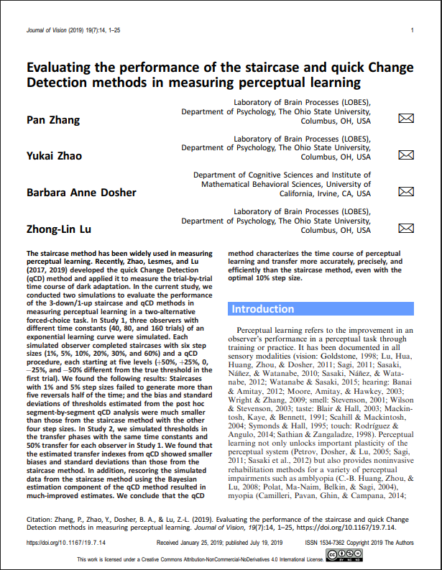
Ambiguity Calibration
Staircase Calibration
Second Order (SO) and Motion Energy (ME)
10° from fixation
Direction Discrimination Task – Left/Right
Confidence Rating – sure/unsure
3 correct – up
1 incorrect or low confidence – down
Min 75 trials – Max 100
75% - 85% accuracy
5 Reversals in last 20 trials
0.075 SD of last 10 Reversals
Vertical Squish
yₘᵢ_{d} = (y_{A} + y_{B}) / 2
y' = yₘᵢ_{d} + (y - y ₘᵢ_{d}) · sᵧ
Step Size = 0.15
Horizontal Squish
x' = cₓ + (x - cₓ) · sₓ
Step Size = 0.10

Slide 9
Ambiguity Calibration
Staircase Calibration
Second Order (SO) and Motion Energy (ME)
10° from fixation
Direction Discrimination Task – Left/Right
Confidence Rating – sure/unsure
3 correct – up
1 incorrect or low confidence – down
Min 75 trials – Max 100
75% - 85% accuracy
5 Reversals in last 20 trials
0.075 SD of last 10 Reversals
Vertical Squish
yₘᵢ_{d} = (y_{A} + y_{B}) / 2
y' = yₘᵢ_{d} + (y - y ₘᵢ_{d}) · sᵧ
Step Size = 0.15
Horizontal Squish
x' = cₓ + (x - cₓ) · sₓ
Step Size = 0.10

Slide 10
Ambiguity Calibration
Staircase Calibration
Second Order (SO) and Motion Energy (ME)
10° from fixation
Direction Discrimination Task – Left/Right
Confidence Rating – sure/unsure
3 correct – up
1 incorrect or low confidence – down
Min 75 trials – Max 100
75% - 85% accuracy
5 Reversals in last 20 trials
0.075 SD of last 10 Reversals
Vertical Squish
yₘᵢ_{d} = (y_{A} + y_{B}) / 2
y' = yₘᵢ_{d} + (y - y ₘᵢ_{d}) · sᵧ
Step Size = 0.15
Horizontal Squish
x' = cₓ + (x - cₓ) · sₓ
Step Size = 0.10

Slide 11
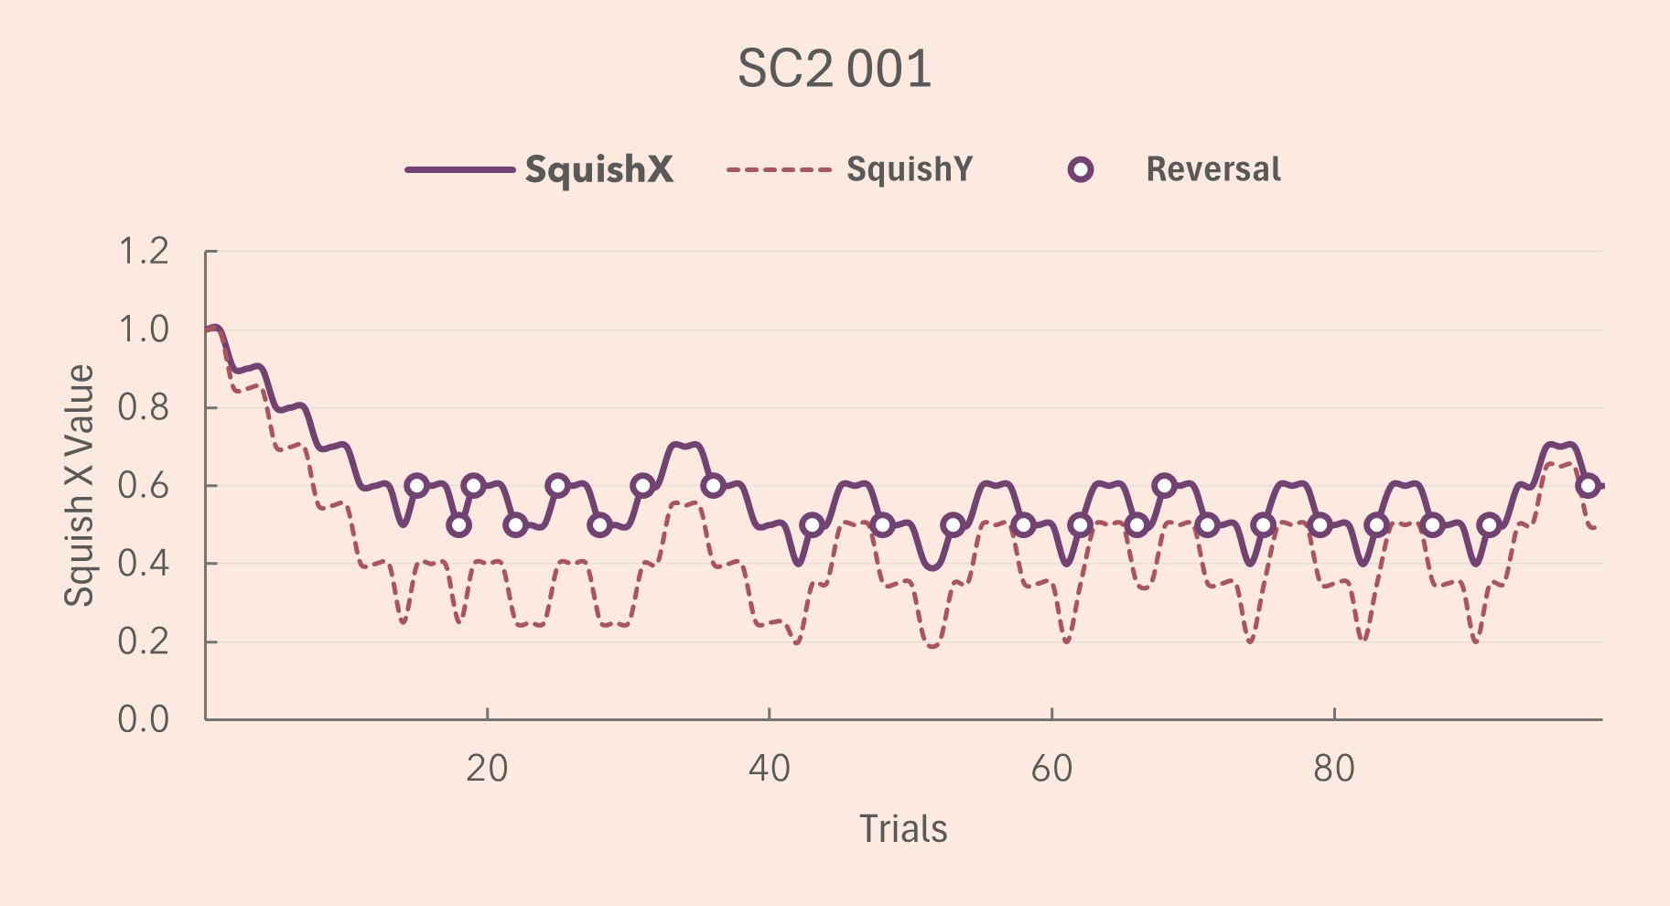
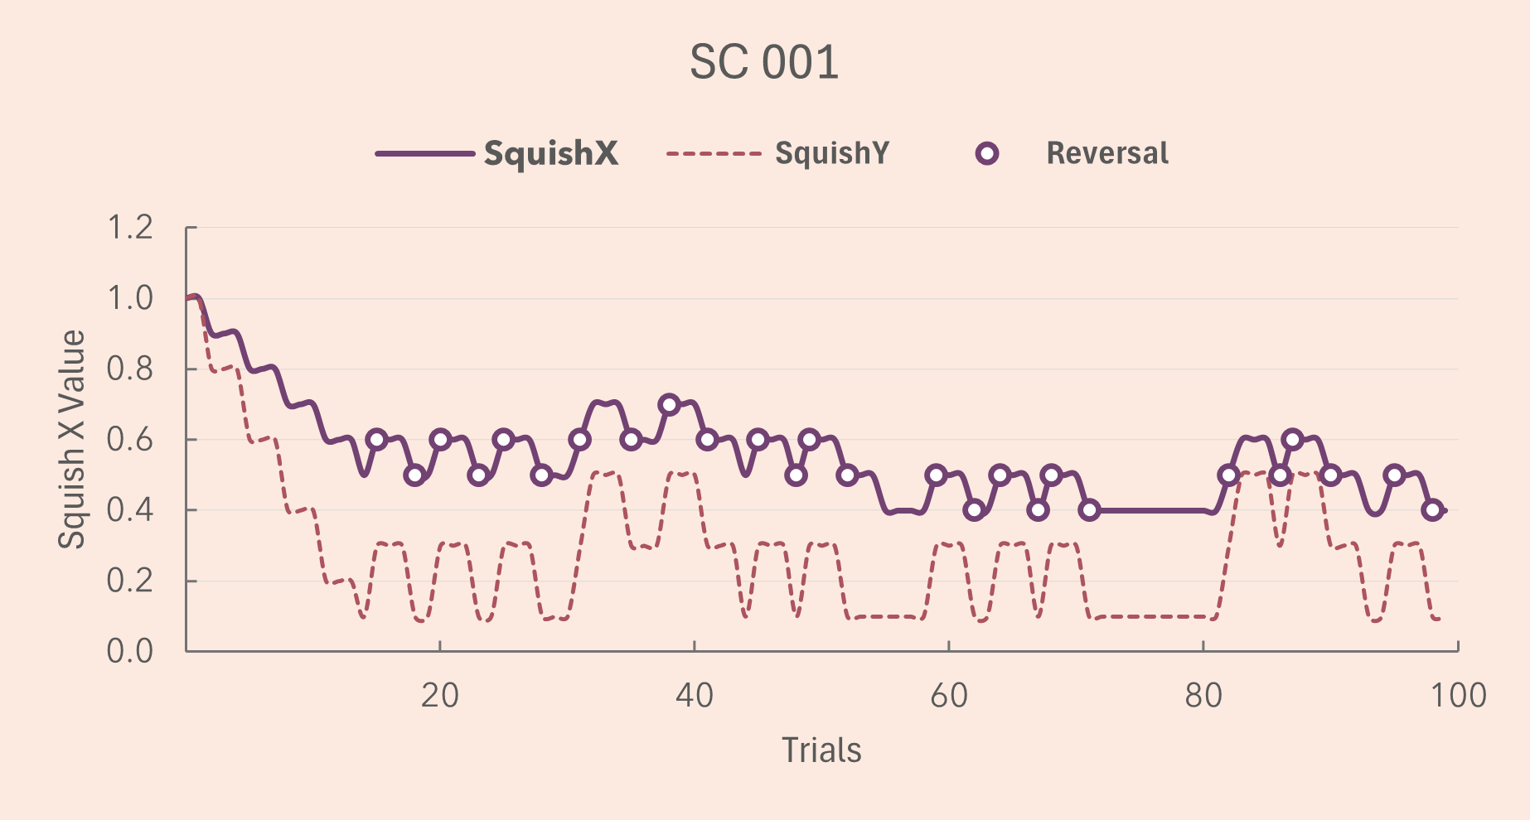
Ambiguity Calibration
Staircase Calibration
Staircase 2 (SC2) – Second Order Motion (SO)
Total Trials: 100
Accuracy: 95.00%
Total Reversals: 22
Reversals in Last 20 Trials: 4
SD of Last 10 Reversals: 0.04216
Mean Threshold (Last 10 Reversals): 0.52000
Staircase 3 (SC3) – Motion Energy (ME)
Total Trials: 100
Accuracy: 95.00%
Total Reversals: 26
Reversals in Last 20 Trials: 6
SD of Last 10 Reversals: 0.06325
Mean Threshold (Last 10 Reversals): 0.48000
X stepsize = 0.1
Y stepsize = 0.15
X stepsize = 0.1
Y stepsize = 0.2

Slide 12
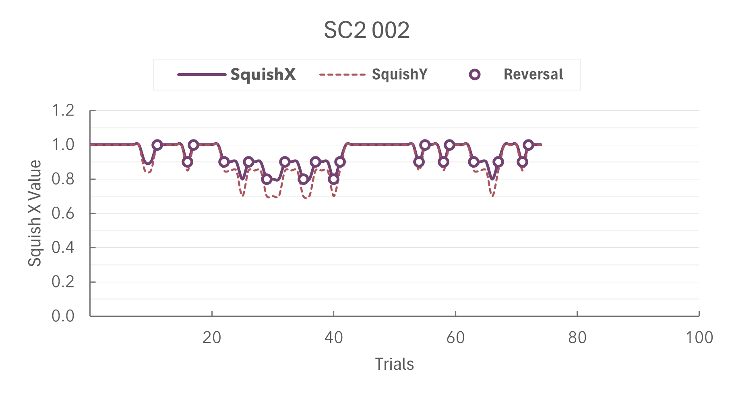
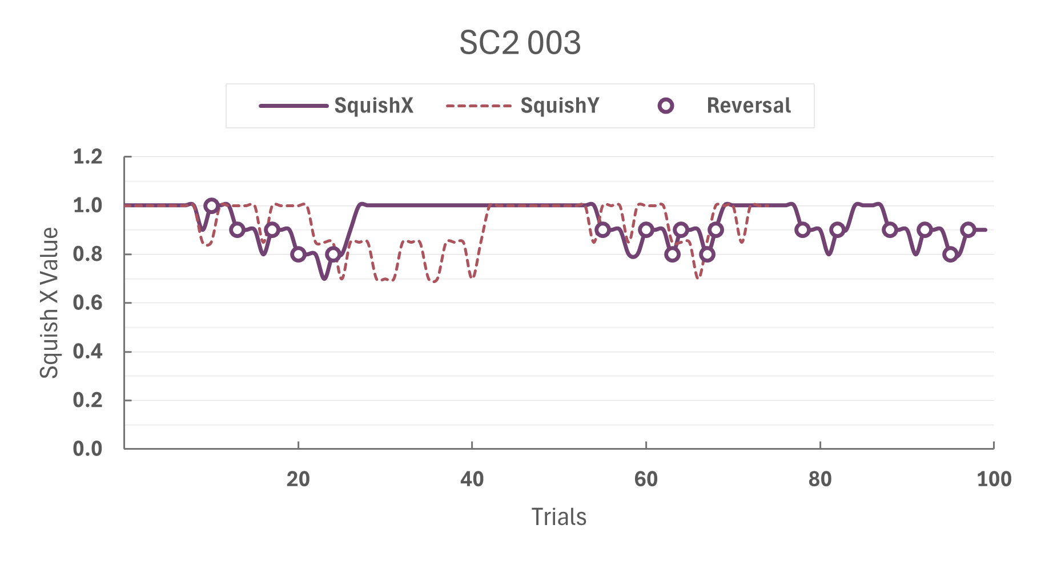
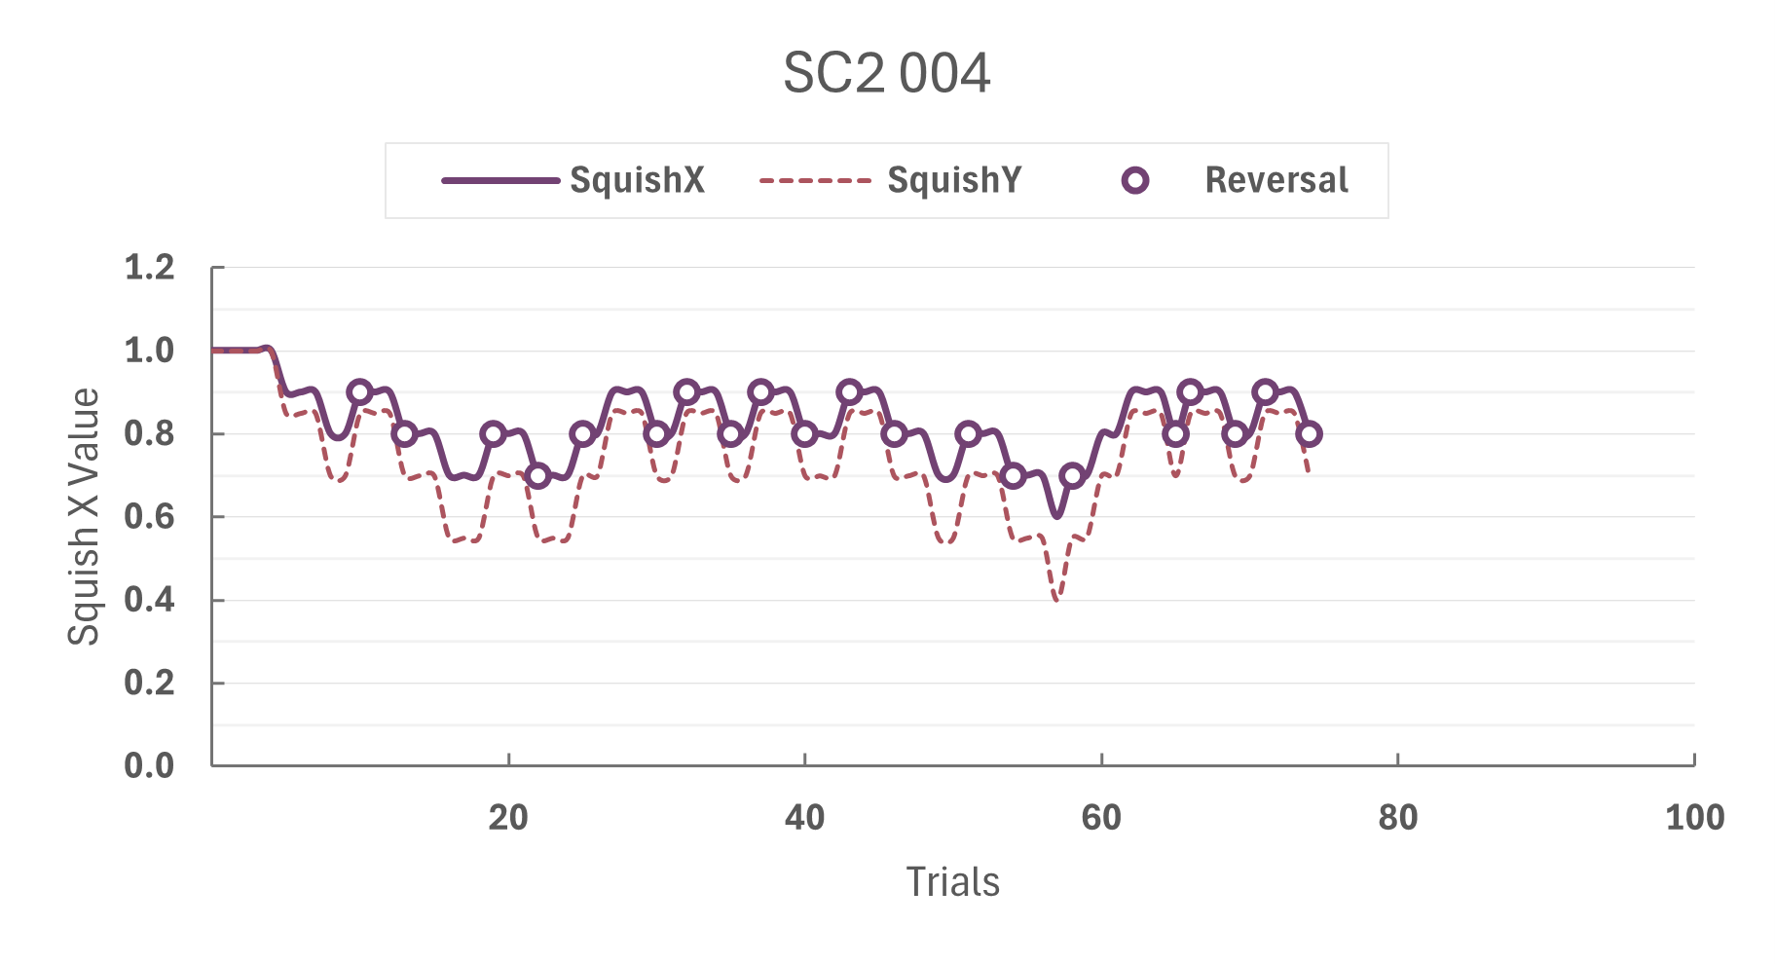
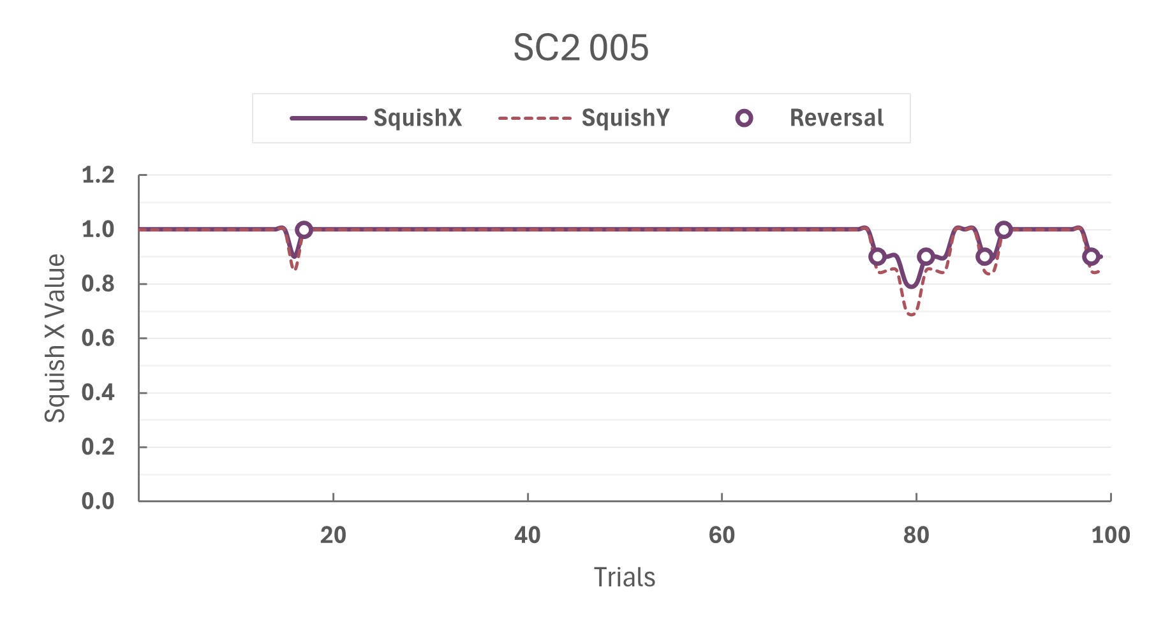
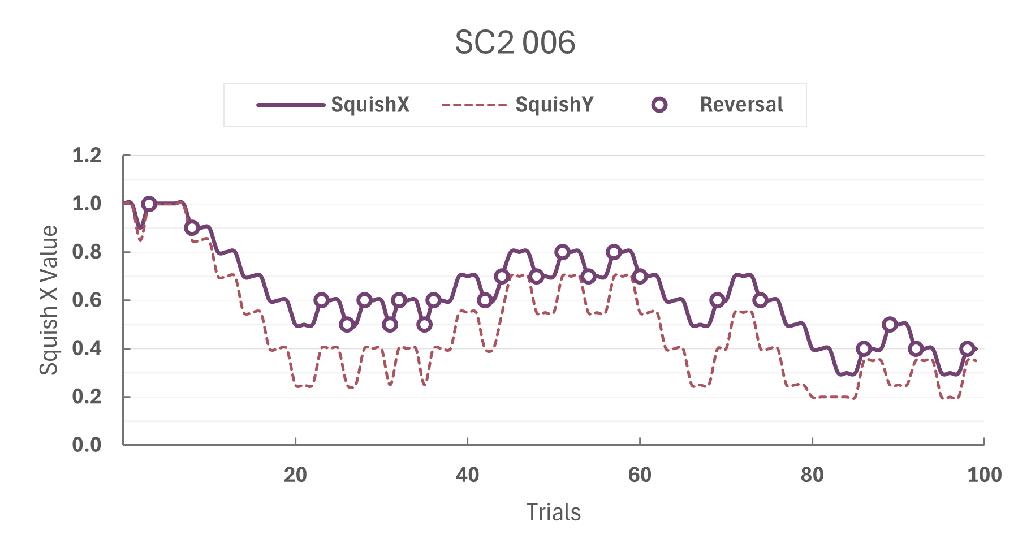
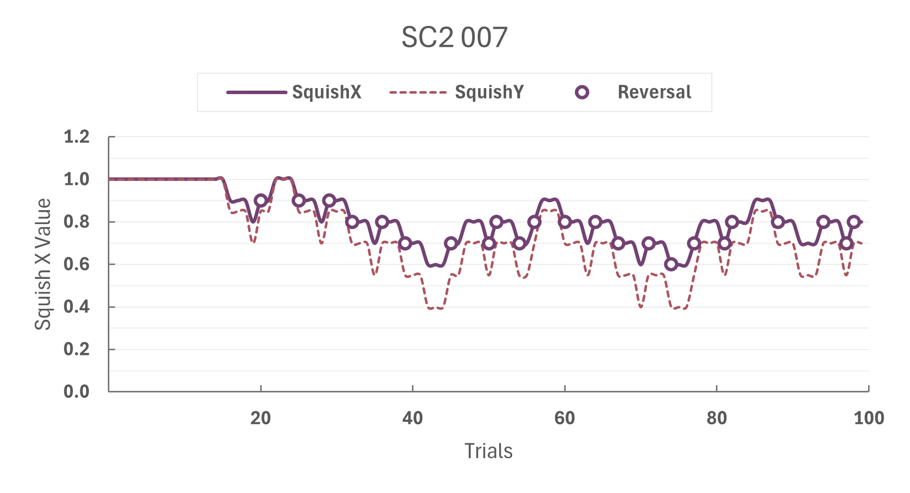
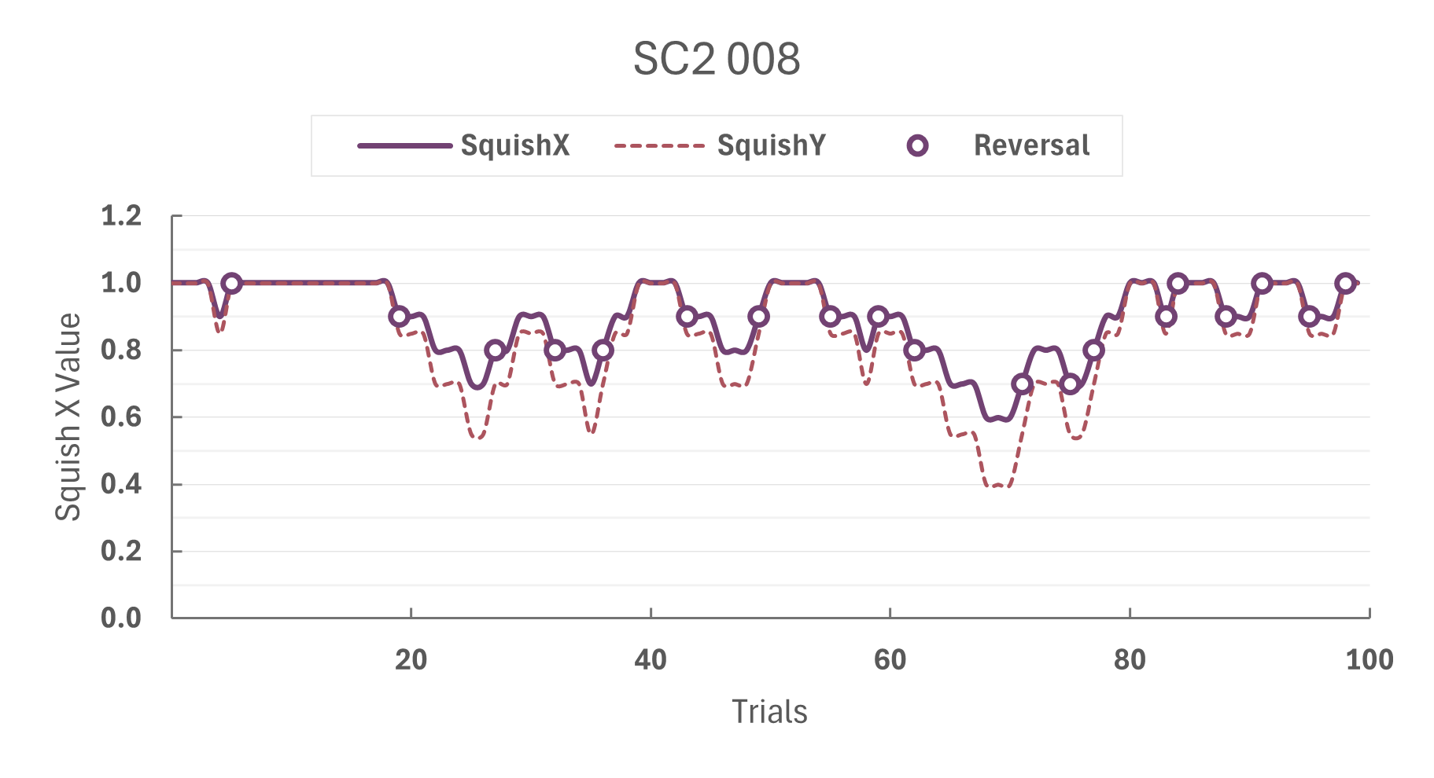
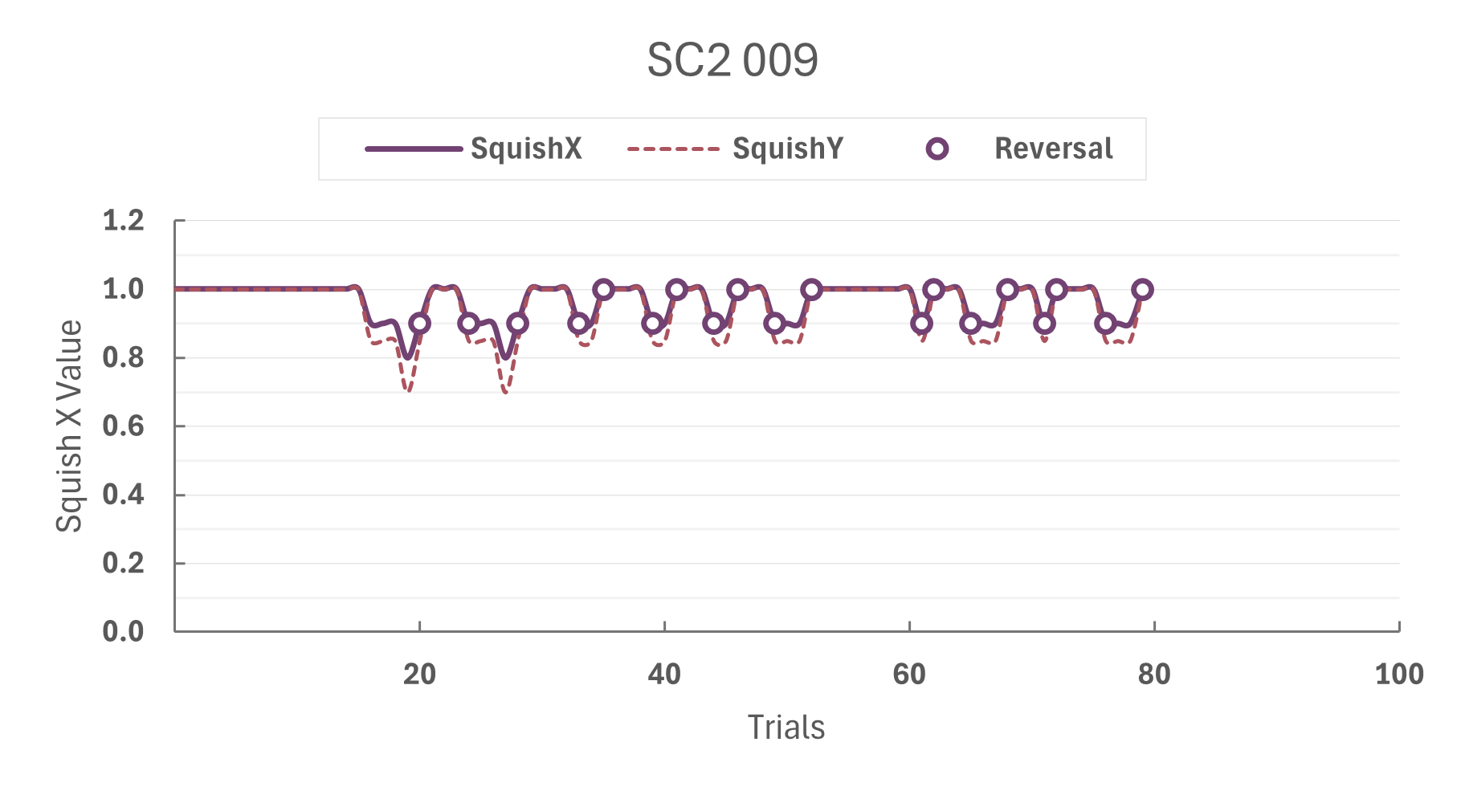
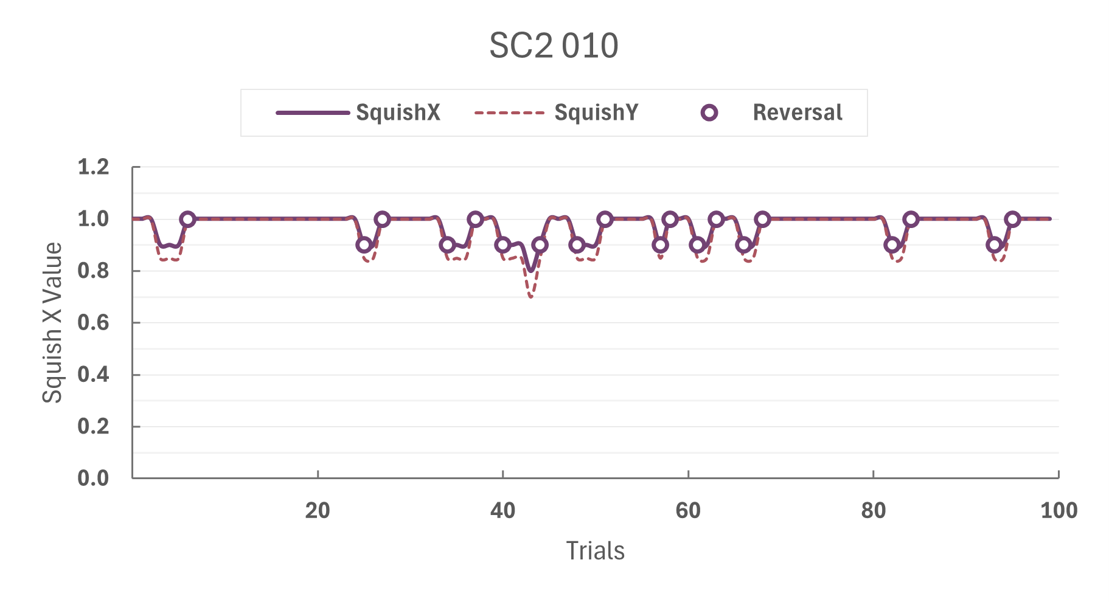
Calibration Staircase SO

Slide 13
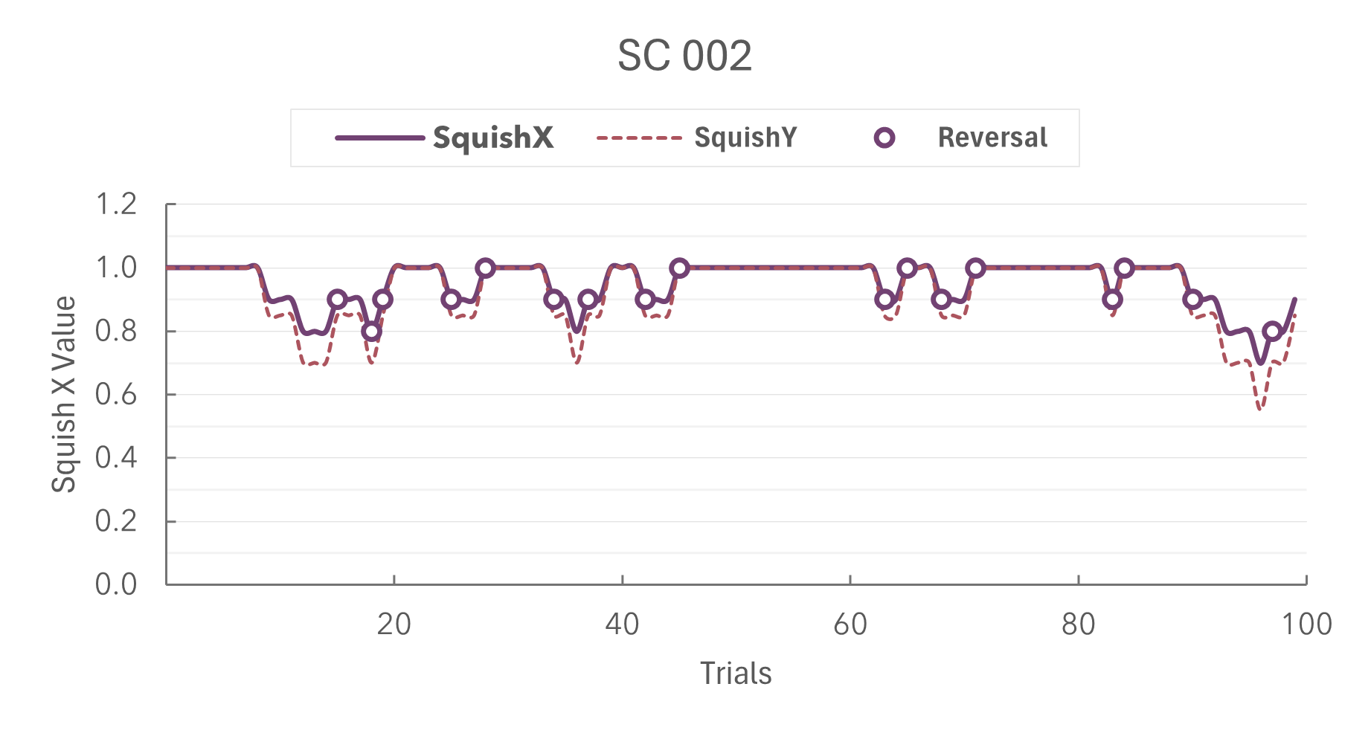
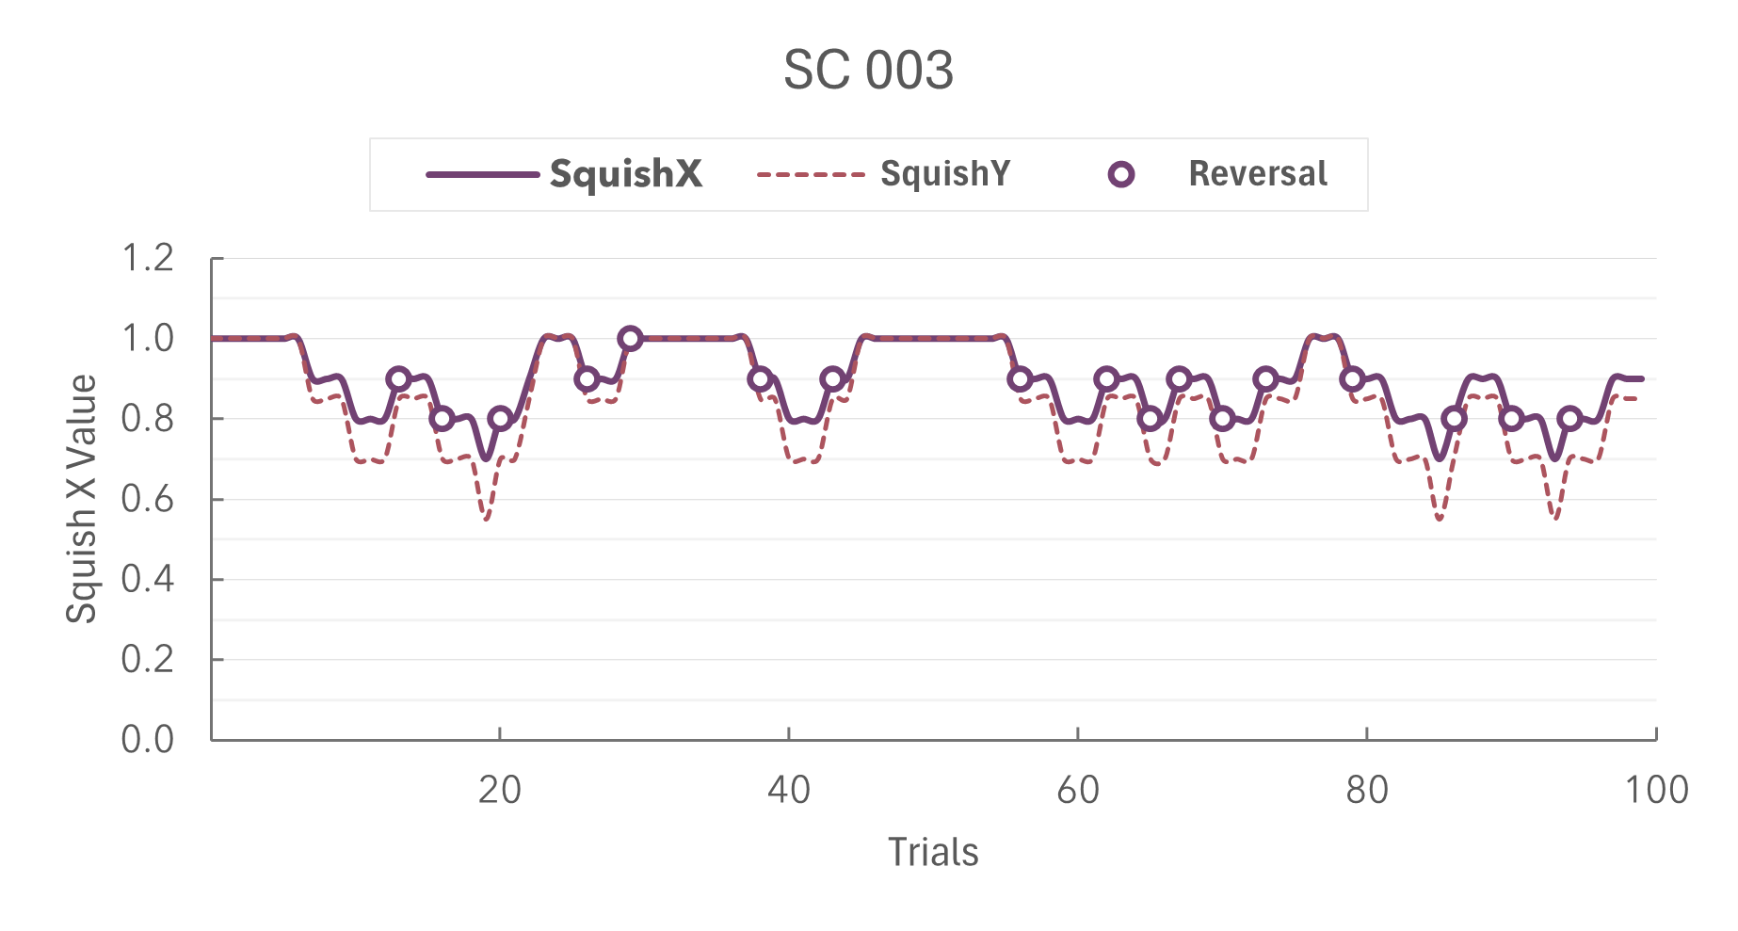
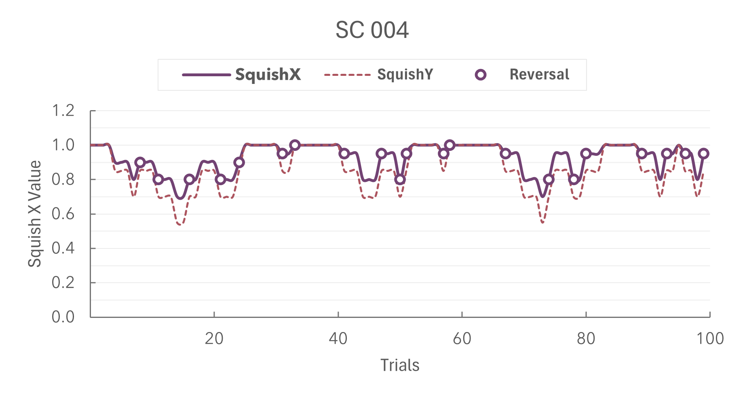
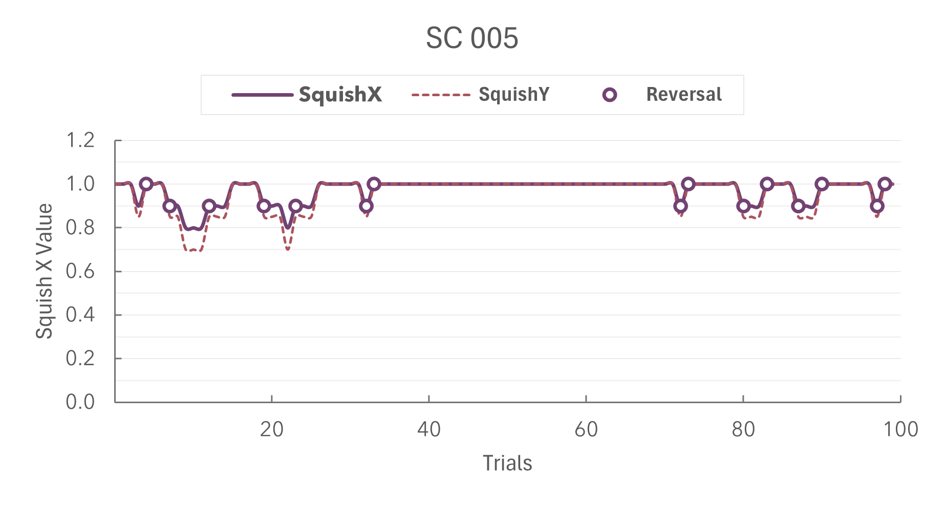
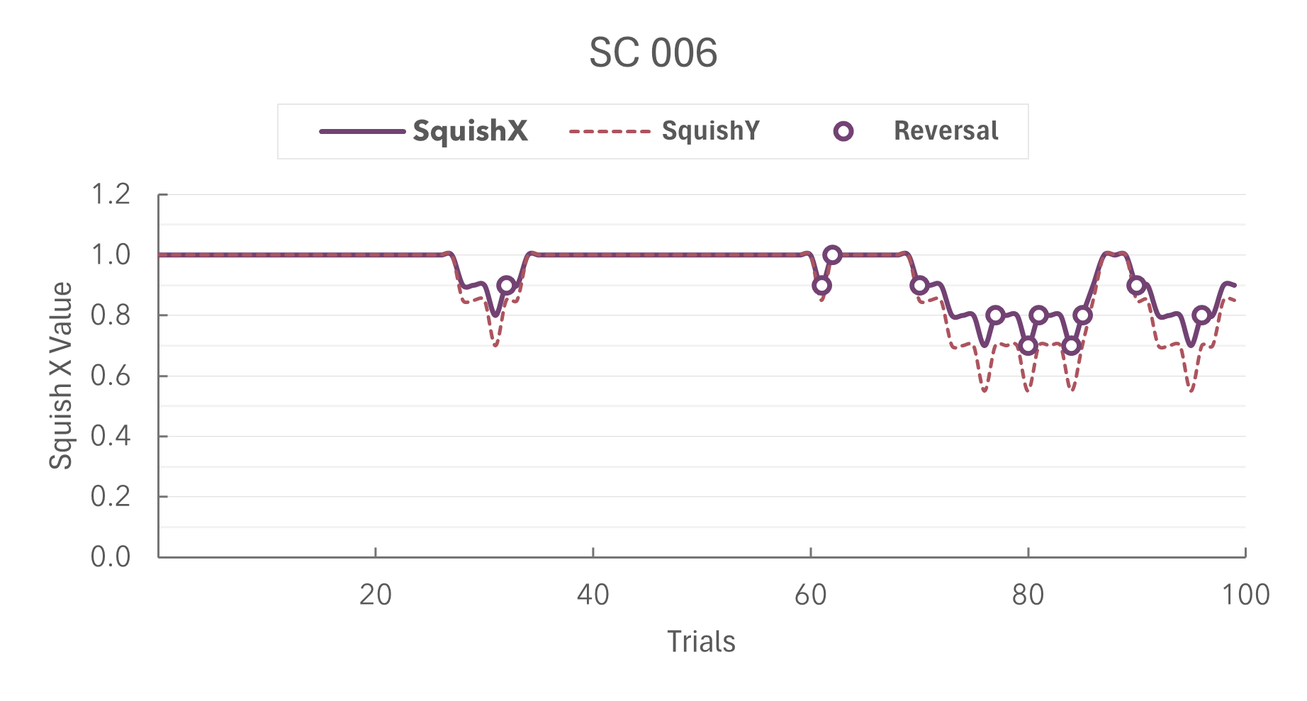
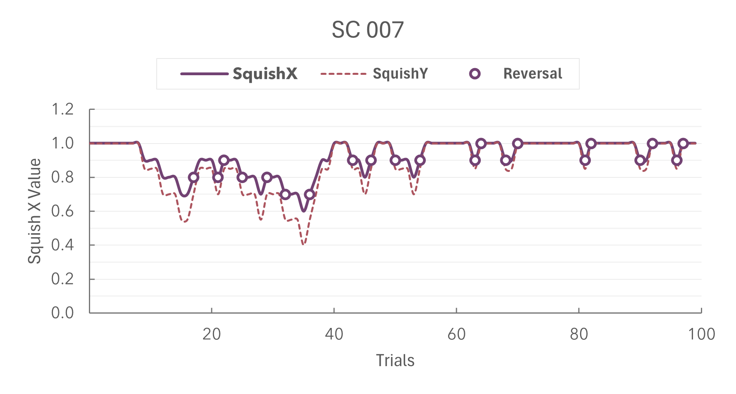
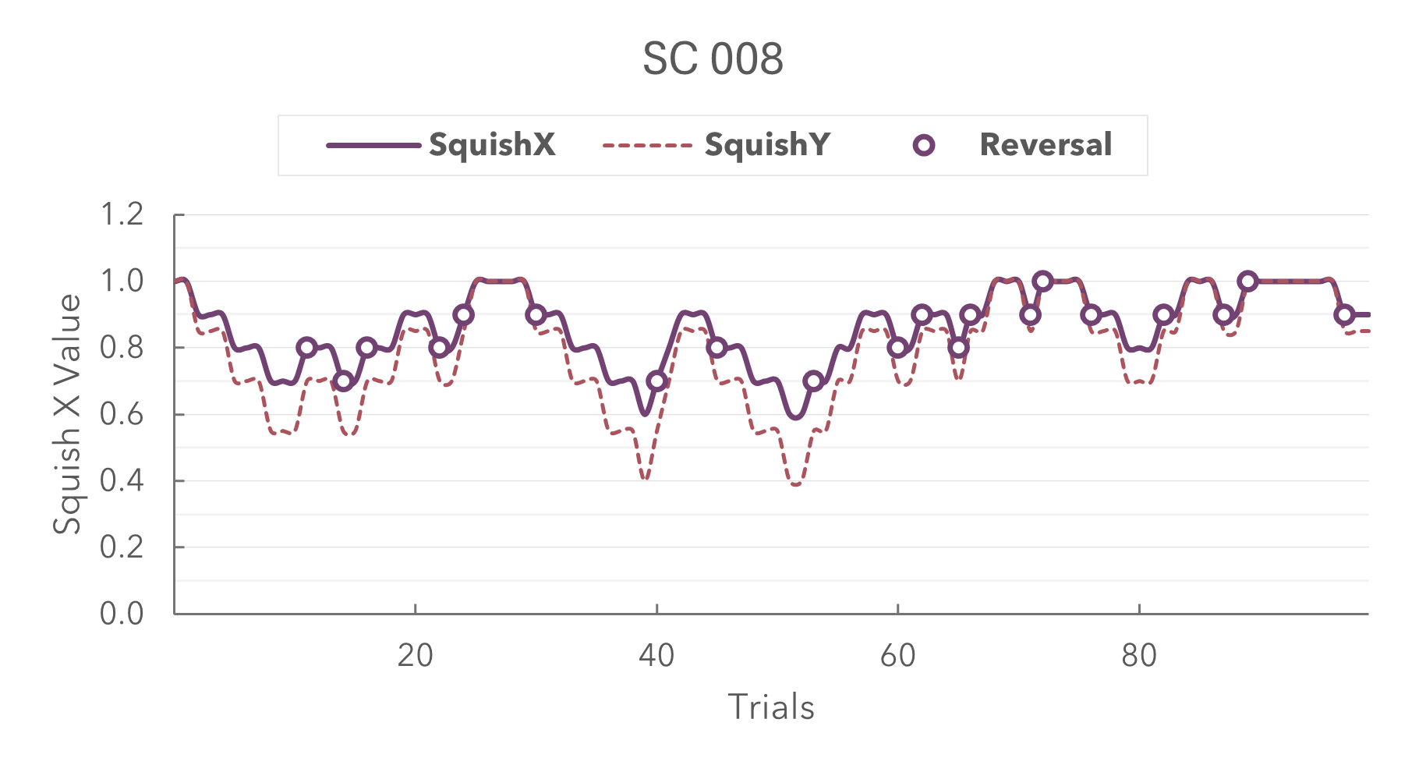
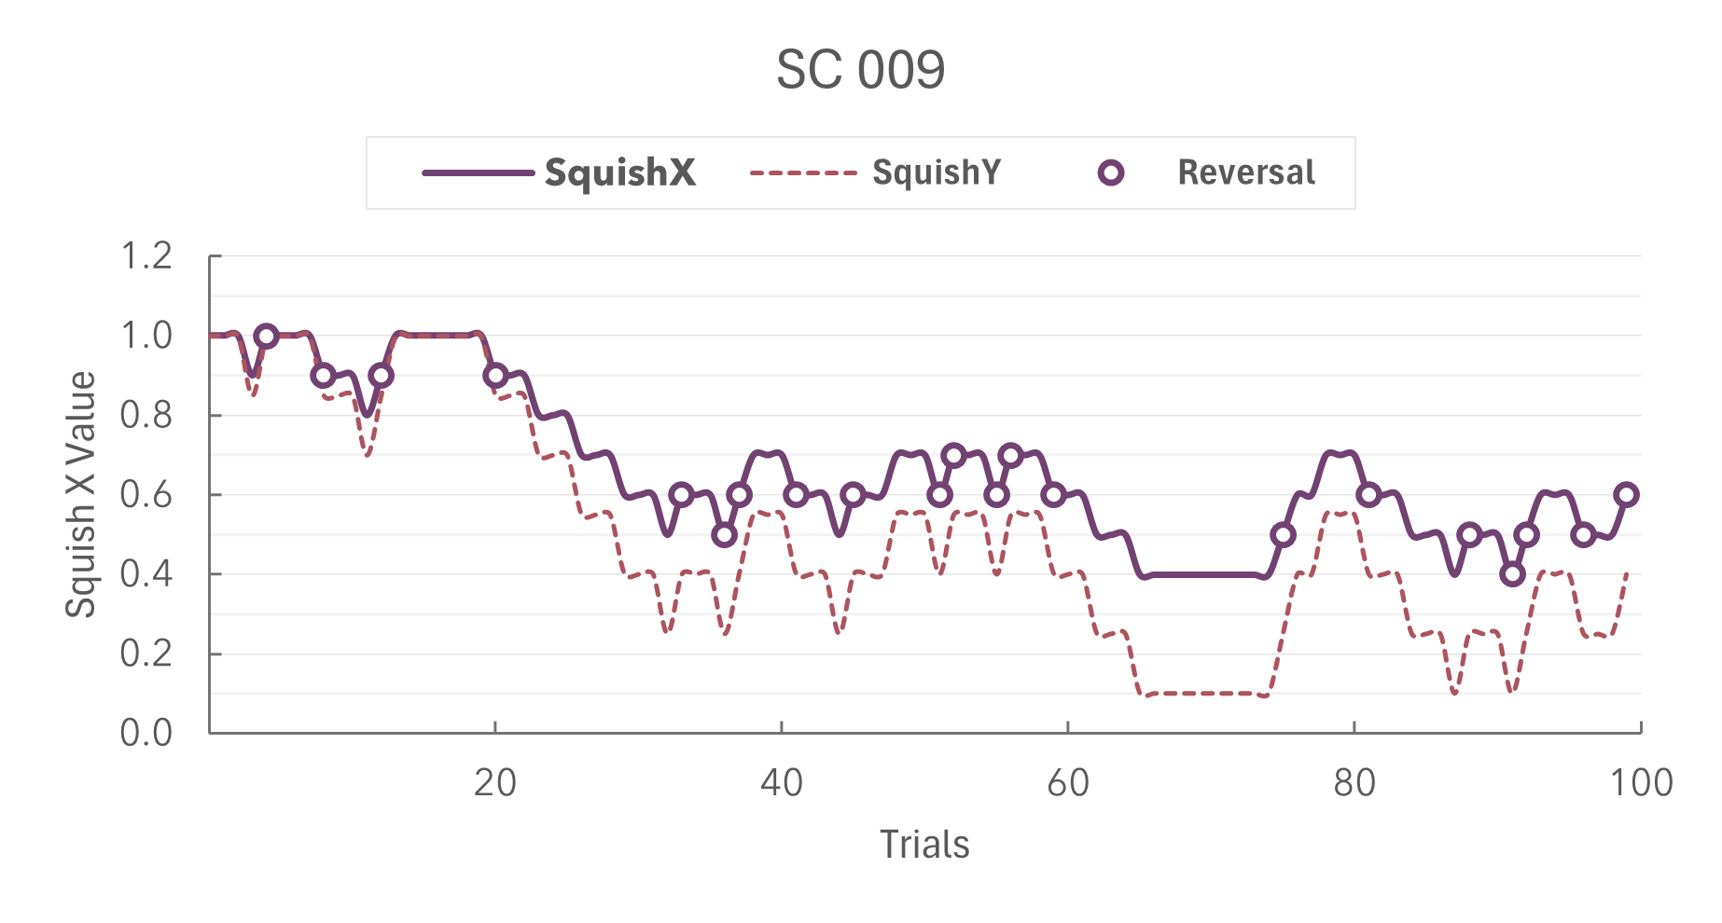
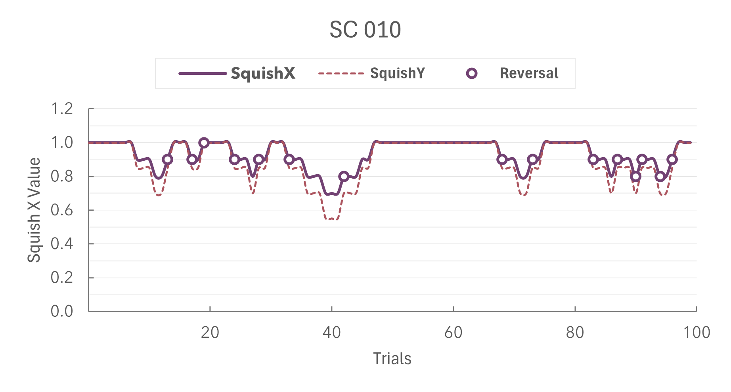
Calibration Staircase ME

Slide 14
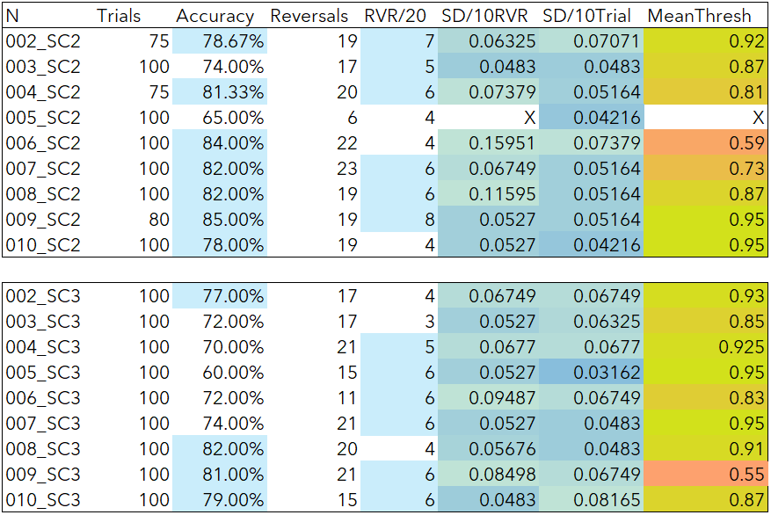
Calibration Staircase ME

Slide 15
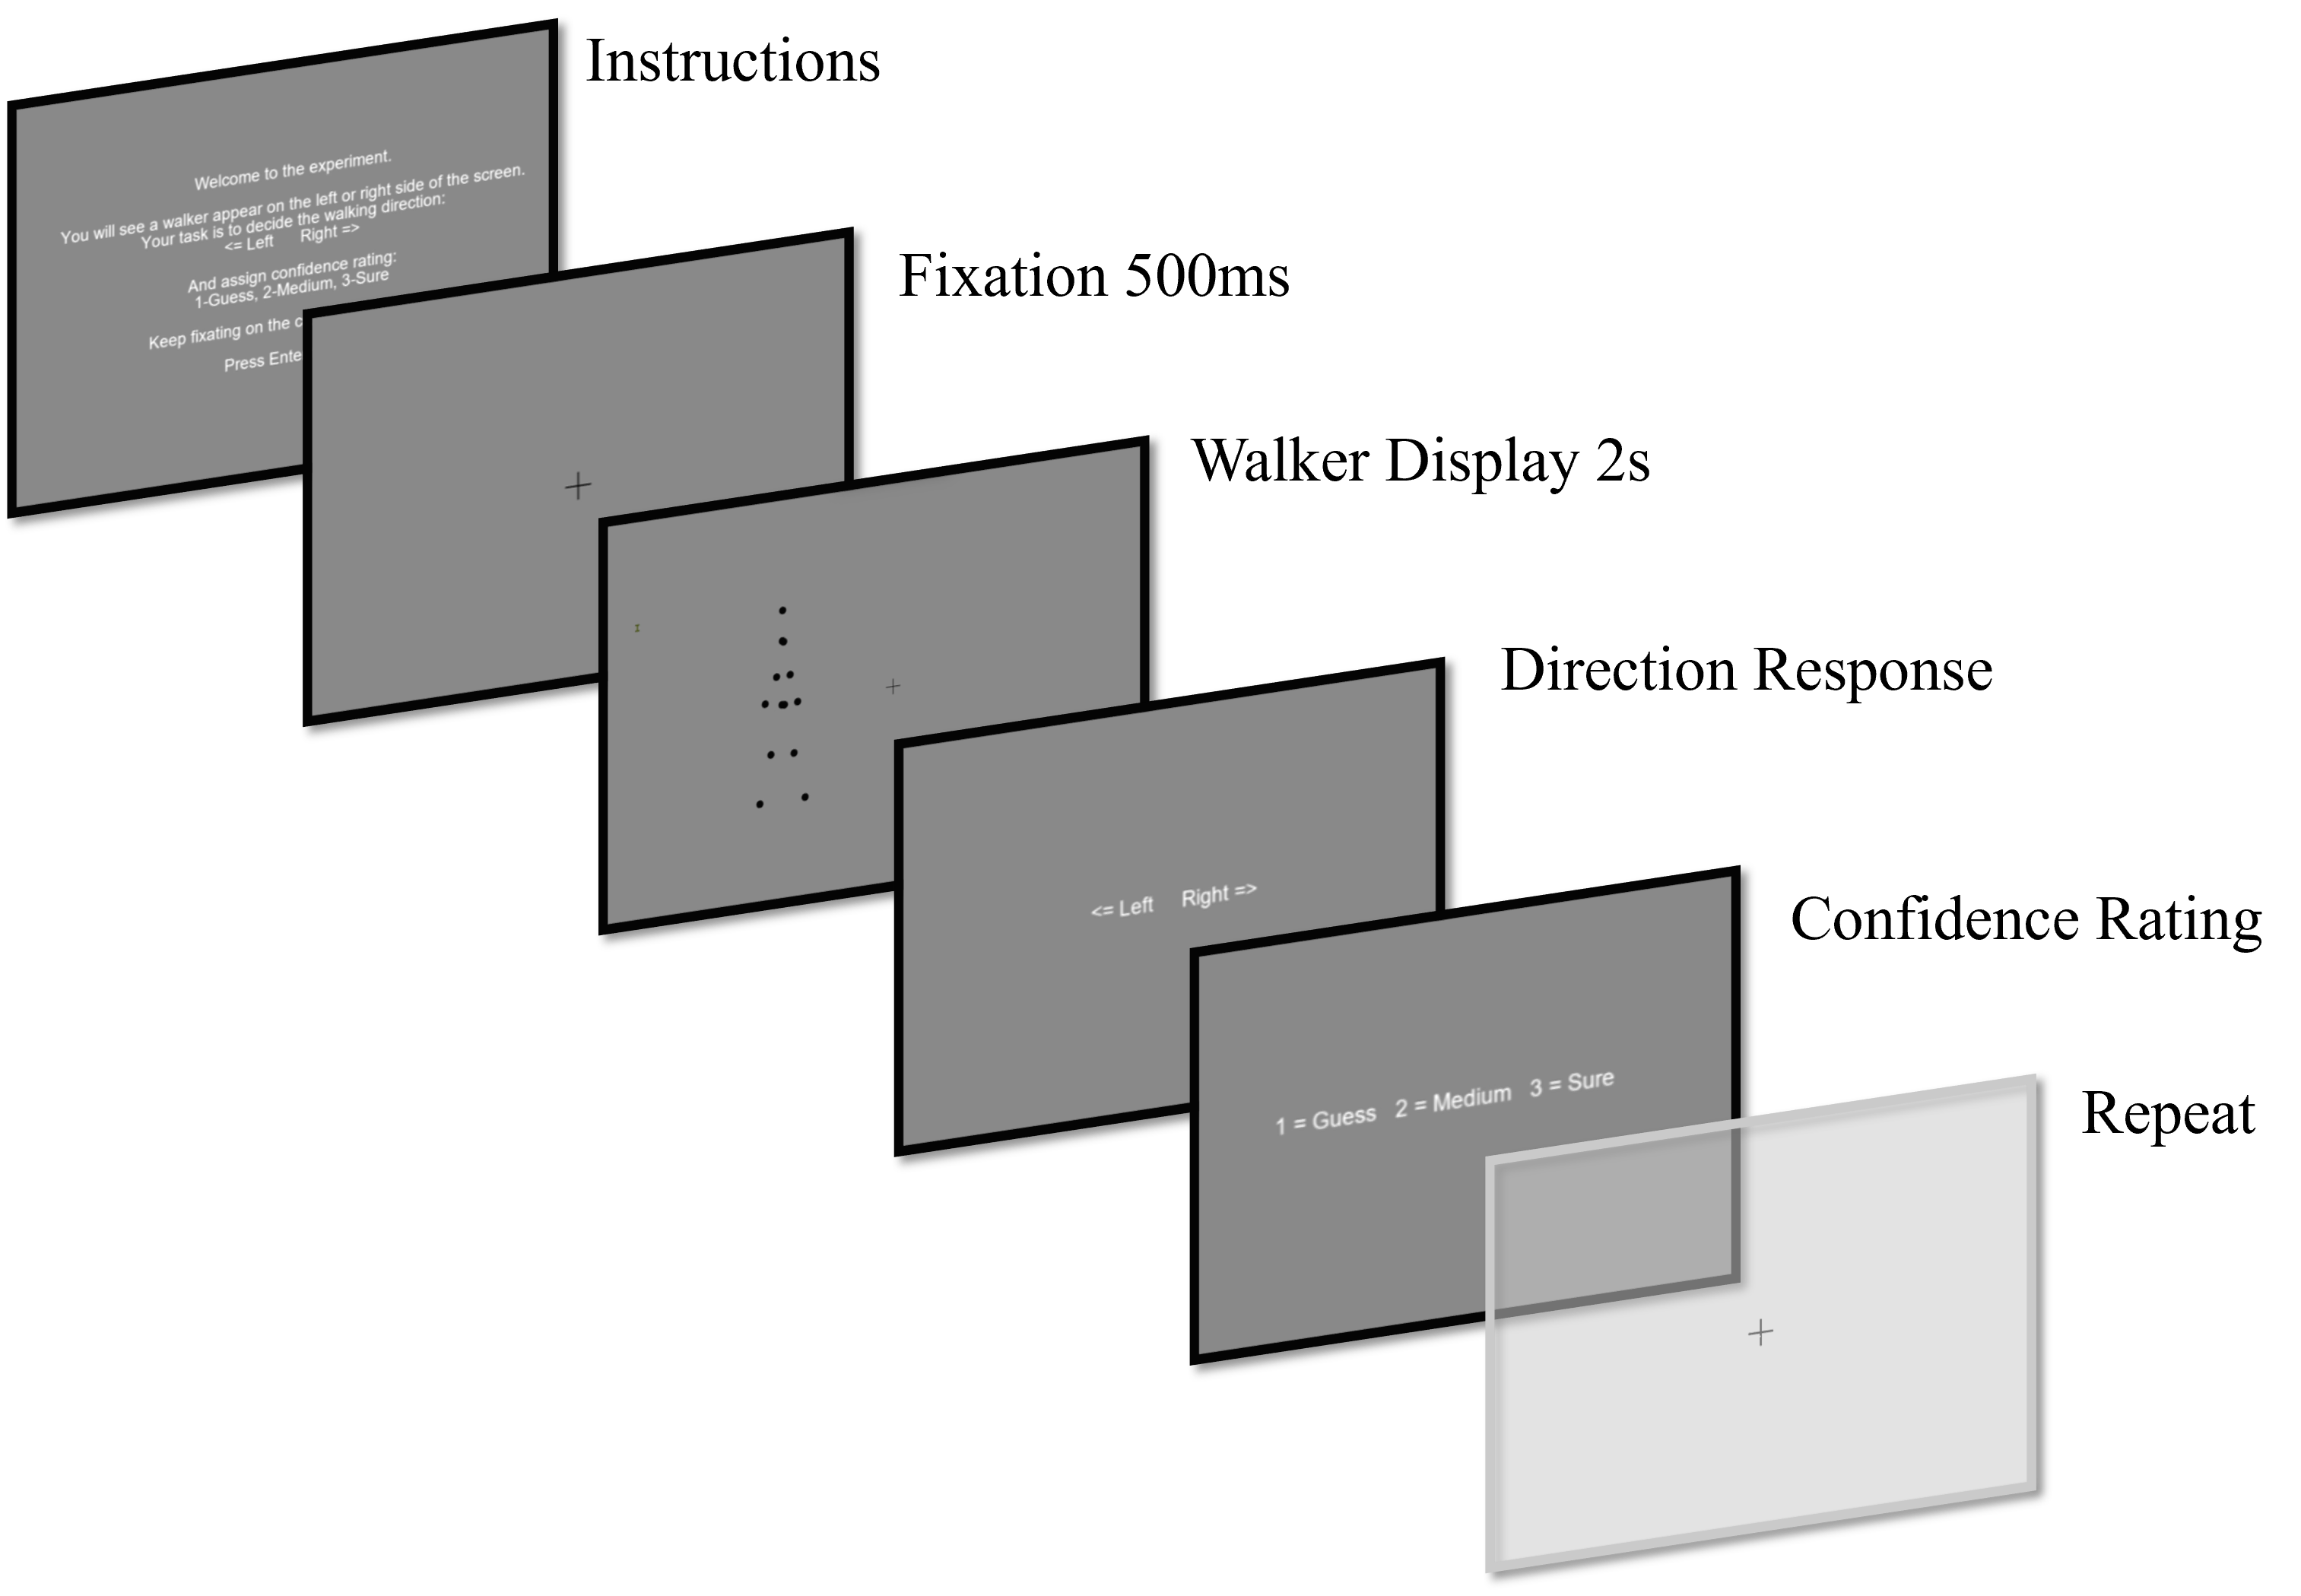
Experiment Design
9 participants
Local Motion Cue Types:
First Order (FO)
Second order (SO)
Motion Energy (ME)
Eccentricities:
0° (fovea)
10°
20°
3 (walker types) * 3 (eccentricity) * 2 (direction) = 18 unique conditions
8 trials per unique condition = 144 trials
Task 2AFC Direction Discrimination
3-point confidence rating

Slide 16
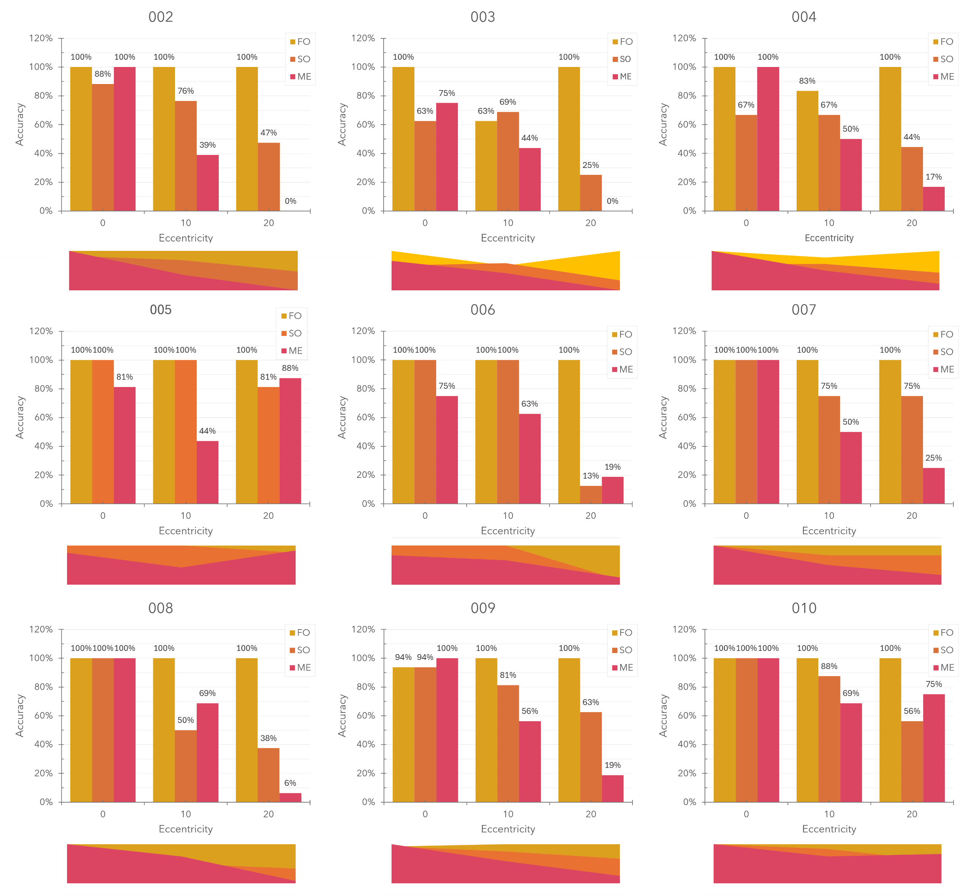
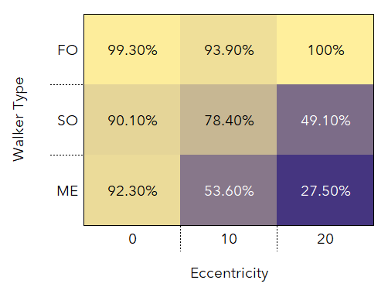

Slide 17
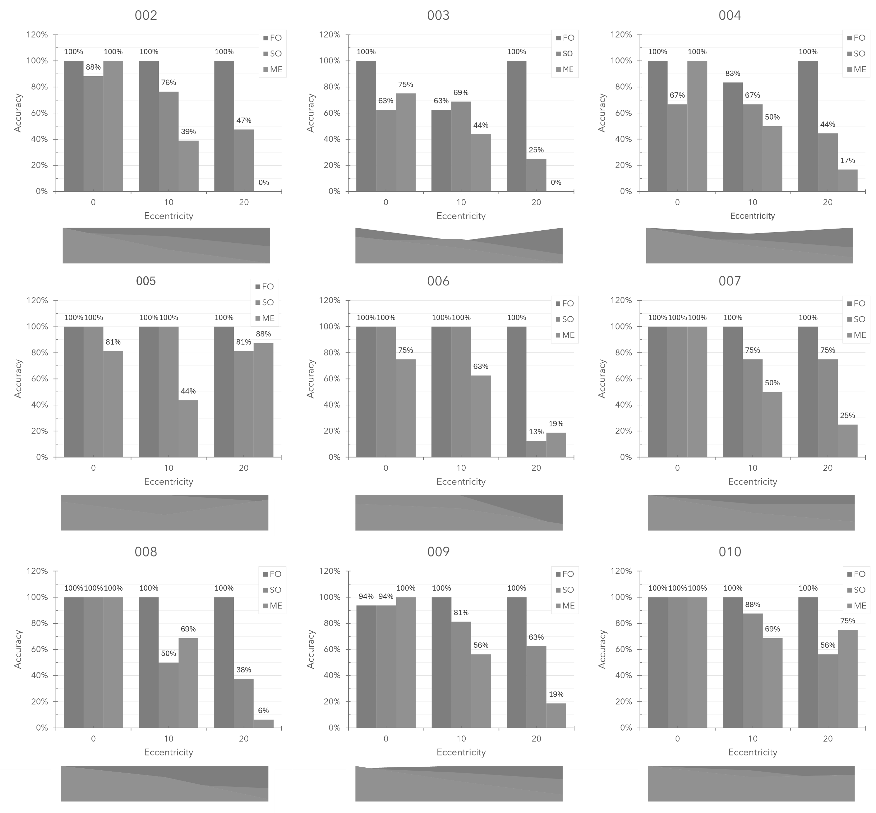
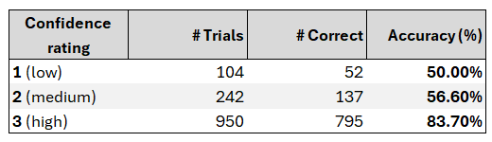
Confidence

Slide 18
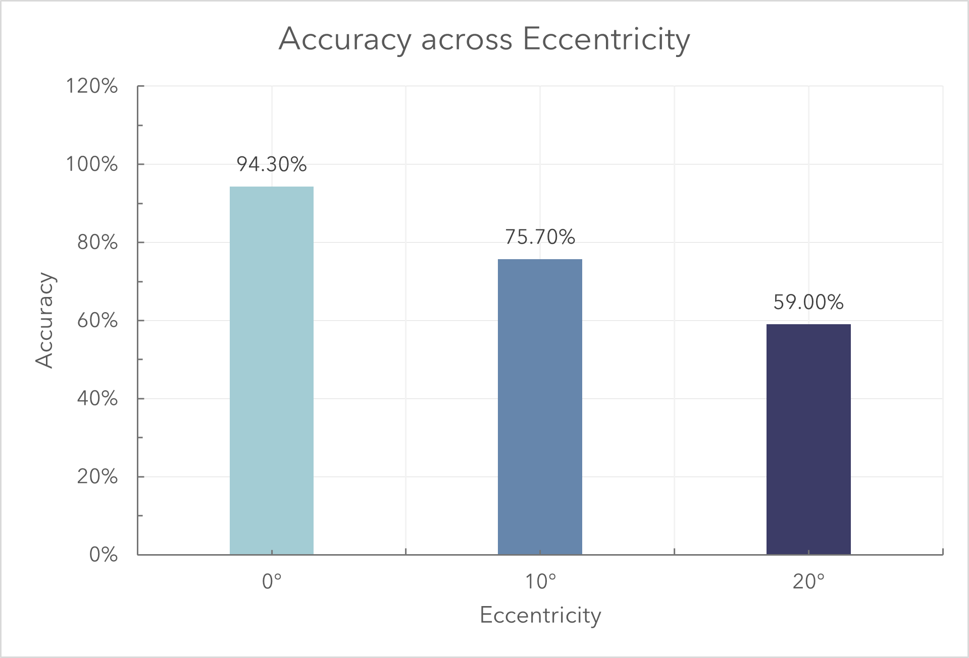
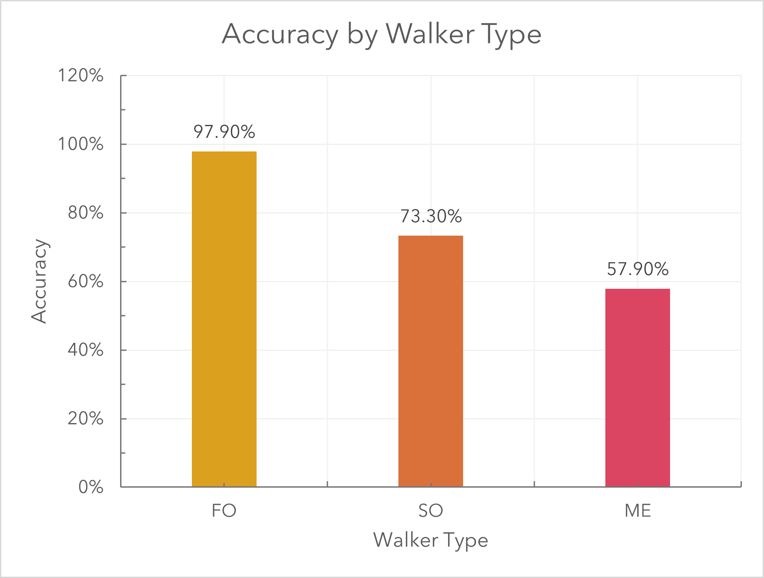
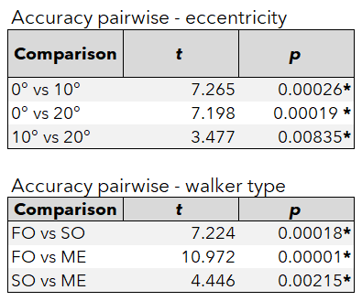
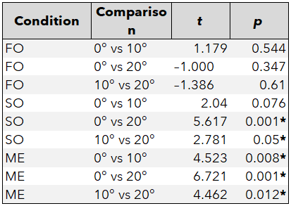
Results
Significant Eccentricity effect on accuracy for SO, ME, while FO retains performance
ME is the hardest to perceive without Spatial information
SO is difficult as spatial information degrades over periphery

Slide 19
Conclusion
First-order (FO) walkers are virtually immune to eccentricity.
≈ 98 % and confidence near the ceiling across the visual field
Second-order (SO) and motion-energy (ME) walkers break down outside the fovea
SO from ≈ 90 % fovea to ≈ 50 % at 20
ME from ≈ 85 % fovea to ≈ 30 % at 20
A genuine mis-perception
≈ 8 % of rating-3 responses were still wrong—clustered in SO/ME at 20°
luminance-defined biological motion robustly across the field,
Second-order cues are not enough when spatial information is absent in periphery
Motion energy cues are vulnerable to misleading when spatial information is absent in periphery.

